Slide 1
Module 3: Parallel Databases and Distributed Databases PARTITION STRATEGIES

Slide 2
Introduction
Parallel machines have become quite common and affordable
prices of microprocessors, memory and disks have dropped sharply
Data storage needs are growing increasingly large
user data at web-scale
100’s of millions of users, petabytes of data
transaction data are collected and stored for analysis.
multimedia objects like images/videos
Parallel storage system requirements
storing large volumes of data
processing time-consuming decision-support queries
providing high throughput for transaction processing
Very high demands on scalability and availability

Slide 3
I/O Parallelism
Reduce the time required to retrieve relations from disk by partitioning the relations on multiple disks, on multiple nodes (computers)
Our description focuses on parallelism across nodes
Same techniques can be used across disks on a node
Horizontal partitioning – tuples of a relation are divided among many nodes such that some subset of tuple resides on each node.
Contrast with vertical partitioning, e.g. r(A,B,C,D) with primary key A into r1(A,B) and r2(A,C,D)
By default, the word partitioning refers to horizontal partitioning

Slide 4
I/O Parallelism
Partitioning techniques (number of nodes = n):
Round-robin:
Send the i^{th} tuple inserted in the relation to node i mod n.
Hash partitioning:
Choose one or more attributes as the partitioning attributes.
Choose hash function h with range 0…n - 1
Let i denote result of hash function h applied to the partitioning attribute value of a tuple. Send tuple to node i.

Slide 5
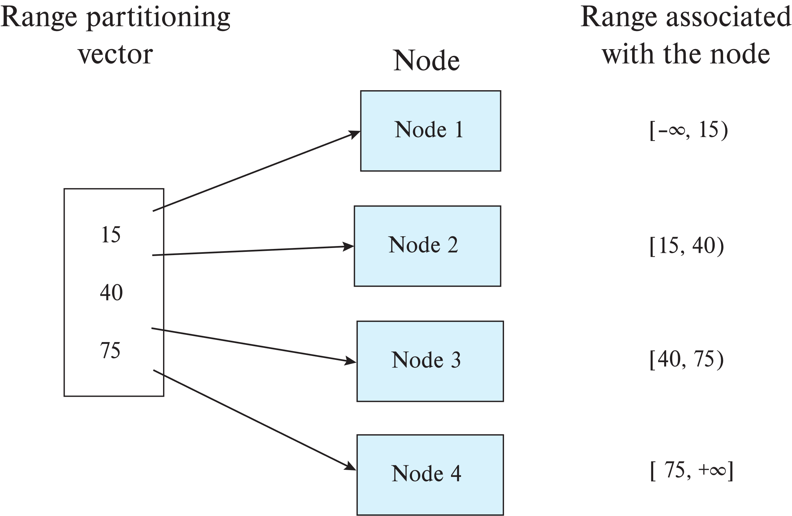
Range Partitioning

Slide 6
I/O Parallelism (Cont.)
Partitioning techniques (cont.):
Range partitioning:
Choose an attribute as the partitioning attribute.
A partitioning vector [v_{o}, v₁, ..., v_{n-2}] is chosen.
Let v be the partitioning attribute value of a tuple. Tuples such that v_{i} ≤ v_{i+1} go to node I + 1. Tuples with v < v₀ go to node 0 and tuples with v ≥ v_{n-2} go to node n-1.
E.g., with a partitioning vector [5,11]
a tuple with partitioning attribute value of 2 will go to node 0,
a tuple with value 8 will go to node 1, while
a tuple with value 20 will go to node2.

Slide 7
Comparison of Partitioning Techniques
Evaluate how well partitioning techniques support the following types of data access:
Scanning the entire relation.
Locating a tuple associatively – point queries.
E.g., r.A = 25.
3. Locating all tuples such that the value of a given attribute
lies within a specified range – range queries.
E.g., 10 ≤ r.A < 25.
Do above evaluation for each of
Round robin
Hash partitioning
Range partitioning

Slide 8
Comparison of Partitioning Techniques (Cont.)
Round robin:
Best suited for sequential scan of entire relation on each query.
All nodes have almost an equal number of tuples; retrieval work is thus well balanced between nodes.
All queries must be processed at all nodes
Hash partitioning:
Good for sequential access
Assuming hash function is good, and partitioning attributes form a key, tuples will be equally distributed between nodes
Good for point queries on partitioning attribute
Can lookup single node, leaving others available for answering other queries.
Range queries inefficient, must be processed at all nodes

Slide 9
Comparison of Partitioning Techniques (Cont.)
Range partitioning:
Provides data clustering by partitioning attribute value.
Good for sequential access
Good for point queries on partitioning attribute: only one node needs to be accessed.
For range queries on partitioning attribute, one to a few nodes may need to be accessed
Remaining nodes are available for other queries.
Good if result tuples are from one to a few blocks.
But if many blocks are to be fetched, they are still fetched from one to a few nodes, and potential parallelism in disk access is wasted
Example of execution skew.

Slide 10
Types of Skew
Data-distribution skew: some nodes have many tuples, while others may have fewer tuples. Could occur due to
Attribute-value skew.
Some partitioning-attribute values appear in many tuples
All the tuples with the same value for the partitioning attribute end up in the same partition.
Can occur with range-partitioning and hash-partitioning.
Partition skew.
Load Imbalance, even without attribute –value skew
Badly chosen range-partition vector may assign too many tuples to some partitions and too few to others.
Less likely with hash-partitioning

Slide 11
Types of Skew (Cont.)
Note that execution skew can occur even without data distribution skew
E.g. relation range-partitioned on date, and most queries access tuples with recent dates
Data-distribution skew can be avoided with range-partitioning by creating balanced range-partitioning vectors
We assume for now that partitioning is static, that is partitioning vector is created once and not changed
Any change requires repartitioning
Dynamic partitioning once allows partition vector to be changed in a continuous manner

Slide 12
Handling Skew in Range-Partitioning
To create a balanced partitioning vector
Sort the relation on the partitioning attribute.
Construct the partition vector by scanning the relation in sorted order as follows.
After every 1/n^{th} of the relation has been read, the value of the partitioning attribute of the next tuple is added to the partition vector.
n denotes the number of partitions to be constructed.
Imbalances can result if duplicates are present in partitioning attributes.
To reduce cost
Partitioning vector can be created using a random sample of tuples
Alternatively histograms can be used to create the partitioning vector

Slide 13
Histograms
Histogram on attribute age of relation person
Equi-width histograms
Equi-depth histograms
break up range such that each range has (approximately) the same number of tuples
E.g. (4, 8, 14, 19)
Assume uniform distribution within each range of the histogram
Create partitioning vector for required number of partitions based on histogram

Slide 14
Virtual Node Partitioning
Key idea: pretend there are several times (10x to 20x) as many virtual nodes as real nodes
Virtual nodes are mapped to real nodes
Tuples partitioned across virtual nodes using range-partitioning vector
Hash partitioning is also possible
Mapping of virtual nodes to real nodes
Round-robin: virtual node i mapped to real node (i mod n)+1
Mapping table: mapping table virtual_to_real_map[] tracks which virtual node is on which real node
Allows skew to be handled by moving virtual nodes from more loaded nodes to less loaded nodes
Both data distribution skew and execution skew can be handled

Slide 15
Handling Skew Using Virtual Node Partitioning
Basic idea:
If any normal partition would have been skewed, it is very likely the skew is spread over a number of virtual partitions
Skewed virtual partitions tend to get spread across a number of nodes, so work gets distributed evenly!
Virtual node approach also allows elasticity of storage
If relation size grows, more nodes can be added and virtual nodes moved to new nodes

Slide 16
Dynamic Repartitioning
Virtual node approach with a fixed partitioning vector cannot handle significant changes in data distribution over time
Complete repartitioning is expensive and intrusive
Dynamic repartitioning can be done incrementally using virtual node scheme
Virtual nodes that become too big can be split
Much like B+-tree node splits
Some virtual nodes can be moved from a heavily loaded node to a less loaded node
Virtual nodes in such a scheme are often called tablets

Slide 17
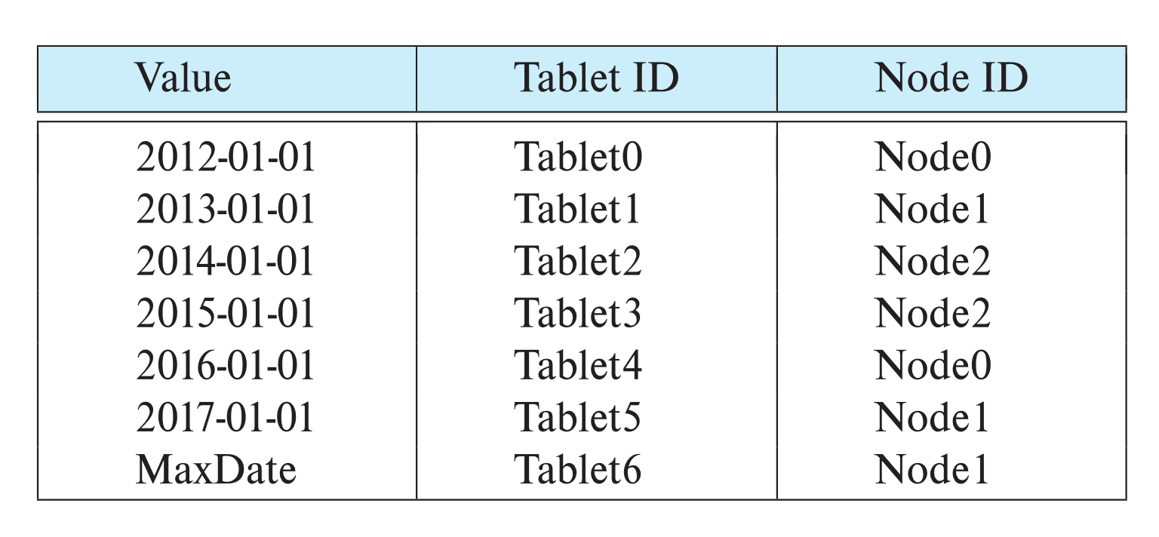
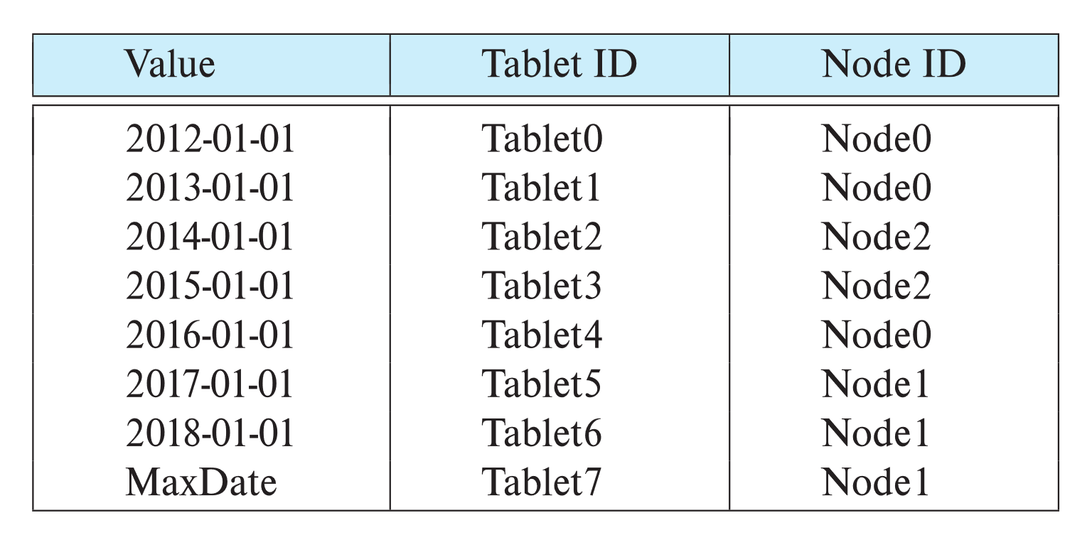
Dynamic Repartitioning
Virtual nodes in such a scheme are often called tablets
Example of initial partition table and partition table after a split of tablet 6 and move of tablet 1
Tablet move
Tablet split

Slide 18
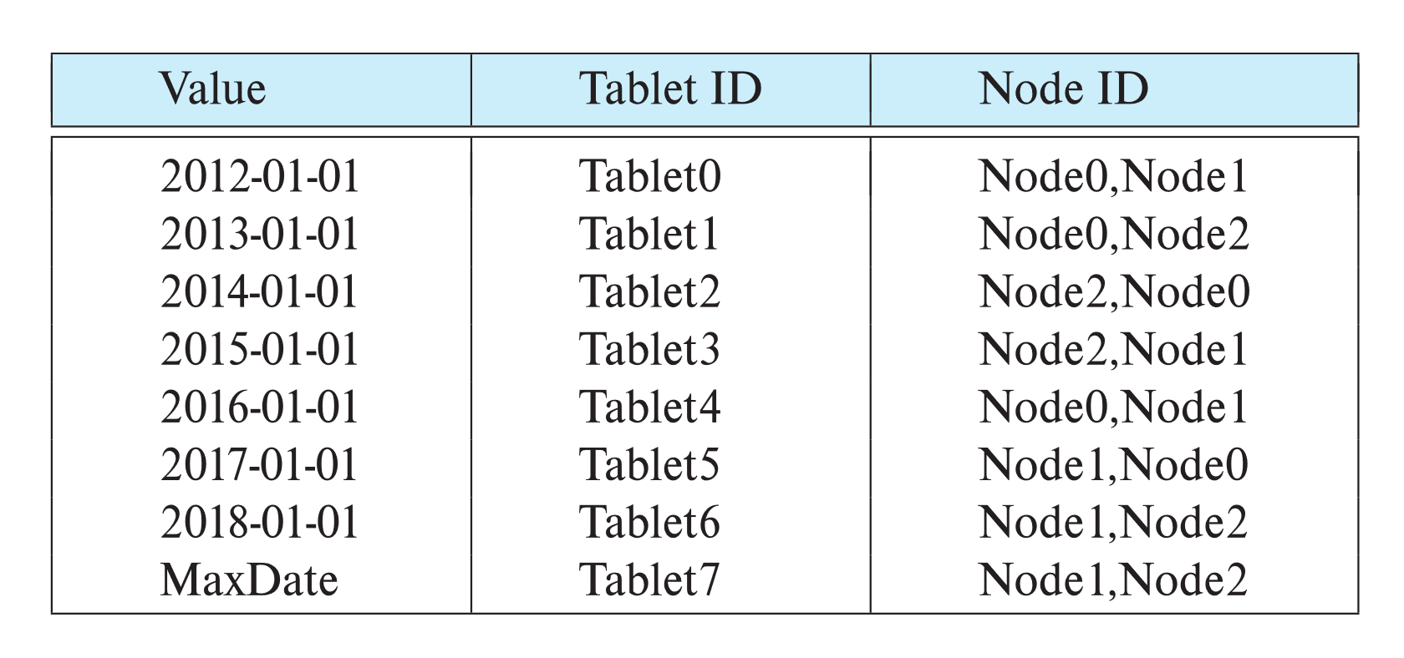
Replication
Goal: availability despite failures
Data replicated at 2, often 3 nodes
Unit of replication typically a partition (tablet)
Requests for data at failed node automatically routed to a replica
Partition table with each tablet replicated at two nodes

Slide 19
Basics: Data Replication
Location of replicas
Replication within a data center
Handles machine failures
Reduces latency if copy available locally on a machine
Replication within/across racks
Replication across data centers
Handles data center failures (power, fire, earthquake, ..), and network partitioning of an entire data center
Provides lower latency for end users if copy is available on nearby data center

Slide 20
Updates and Consistency of Replicas
Replicas must be kept consistent on update
Despite failures resulting in different replicas having different values (temporarily), reads must get the latest value.
Special concurrency control and atomic commit mechanisms to ensure consistency
Master replica (primary copy) scheme
All updates are sent to master, and then replicated to other nodes
Reads are performed at master

Slide 21
Protocols to Update Replicas
Two-phase commit
Coming up in Chapter 23
Assumes all replicas are available
Persistent messaging
Updates are sent as messages with guaranteed delivery
Replicas are updated asynchronously (after original transaction commits)
Eventual consistency
Can lead to inconsistency on reads from replicas
Consensus protocols
Protocol followed by a set of replicas to agree on what updates to perform in what order
Can work even without a designated master

